Slide 1
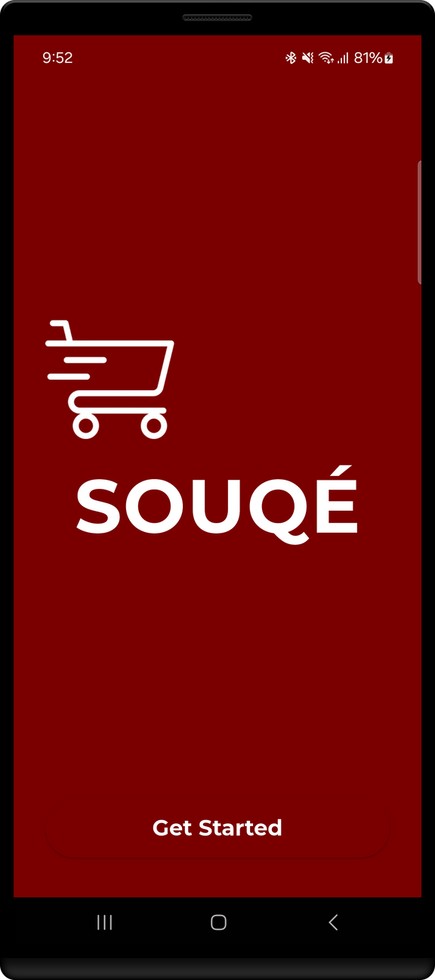

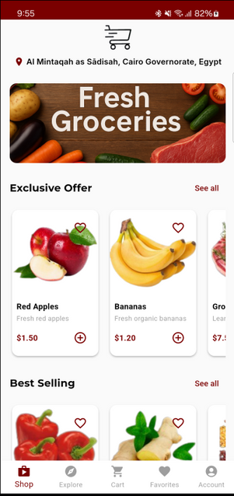
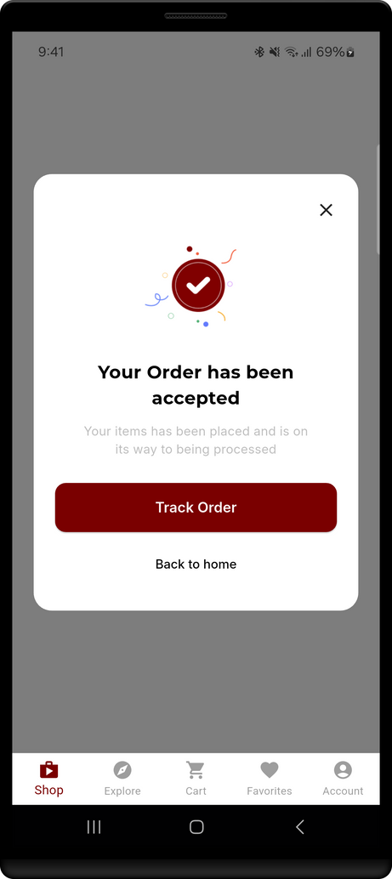
SOUQÉ
APP
GROCERY ON THE GO!

Slide 2

ABOUT APP
The Smart Supermarket App (SOUQÉ) is a user-friendly mobile grocery shopping platform developed using Flutter. SOUQÉ offers smart features such as allergy alerts, personalized suggestions based on user preferences, and real-time order tracking via Google Maps integration. By combining convenience and personalization. SOUQÉ transforms everyday grocery shopping into a streamlined, intelligent, and enjoyable experience.
The app is built for users who value convenience, have dietary needs, and want a smarter, personalized online shopping experience.

Slide 3



FEATURES

Slide 4




01
Allergy Warning System
Automatically alerts users when selected products contain potential allergies, enhancing shopping safety for individuals with dietary restrictions.
02
Shopping Recommendations
Delivers tailored product suggestions based on users' shopping history and preferences, improving convenience and relevance.
03
Google Maps Integration
Enables real-time delivery tracking and location-based services by leveraging Google Maps Api.

Slide 5



04
Favourites and Explore Sections
Enables users to save favorite products and discover new items through curated categories and suggestions.
05
Cart and Order Management
Allows users to add products to their cart, manage current and past orders, and monitor order status in real time.
06
Account Management
Offers easy access to edit personal details, manage saved addresses, and review order history.

Slide 6

07
Firebase Firestore Integration
Utilized for secure and scalable data management, including user authentication, data storage, and order tracking.
☁️
08
Authentication with Google Sign-In
Supports secure user login via email/password or Google accounts, ensuring quick and safe access to the app.

Slide 7

Firebase Firestore Integration
Purpose: Manages backend operations in real-time.
Used for:
Authentication (email, phone, Google)
User profiles (medical info, preferences)
Order storage and updates
Why Firebase?
Secure & real-time data sync.
Scalable and easy to integrate with Flutter.
Impact: Enables smooth login, order tracking, and personalized shopping.

Slide 8
State Management (Provider)
Purpose: Ensures smooth, responsive interactions across the app.
Why Provider?
Separates business logic from UI.
Simplifies code maintenance and scaling.
How It Works in SOUQÉ:
Cart: Real-time updates to total cost and item count.
Favorites: Instant sync across product and favorites views.
Medical Data: User input (e.g., allergies) affects product warnings app-wide.

Slide 9
Packages
Key dependencies in the project include
firebase_core, firebase_auth, cloud_firestore: Backend and data managemen
google_sign_in: Login via Google
google_maps_flutter, geolocator, geocoding: Map and location features
awesome_dialog: Engaging feedback dialogs
intl: Date and time formatting
provider: State management
flutter_launcher_icons: App icon generation

Slide 10
SOUQÉ
Screens

Slide 11
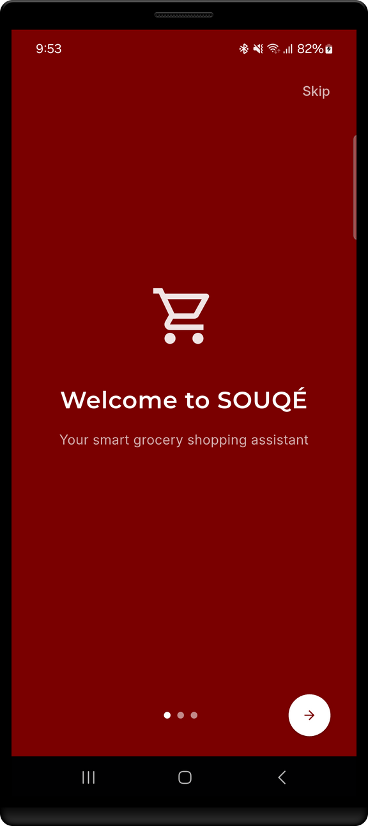
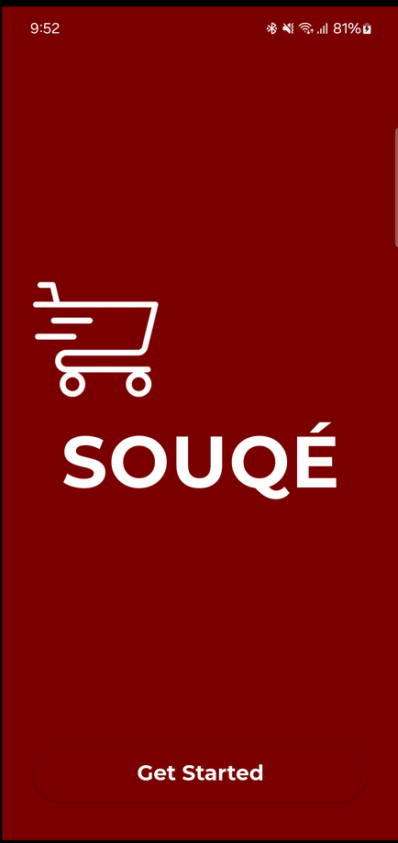
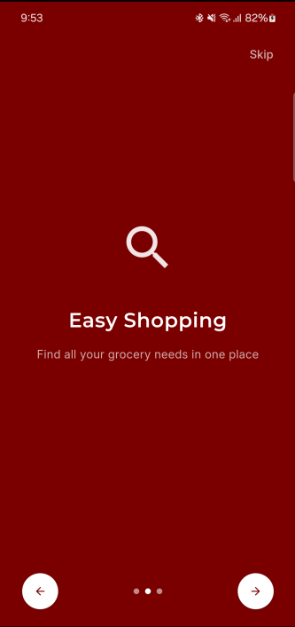
Get Started

Slide 12
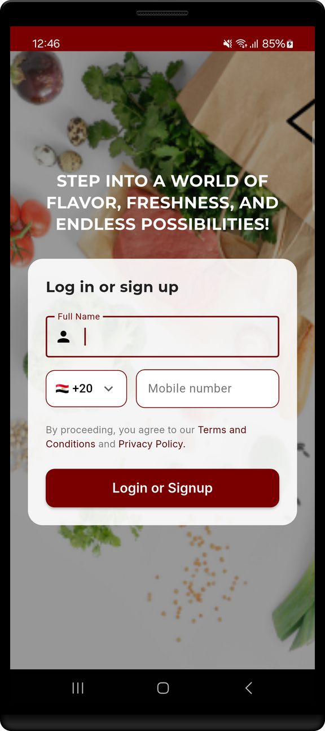
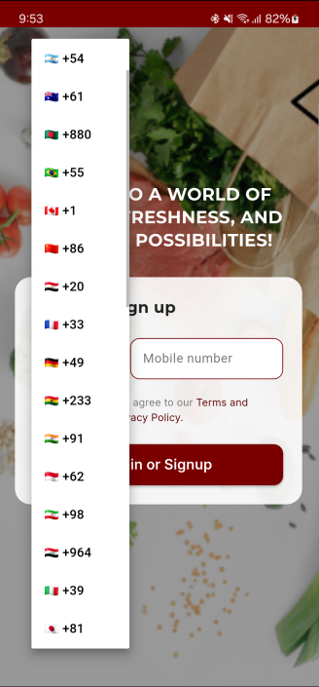
First step
The user must enter their phone number to Log In or Sign Up
There is a display of a list of supported country codes so users can easily select their region for phone authentication.

Slide 13
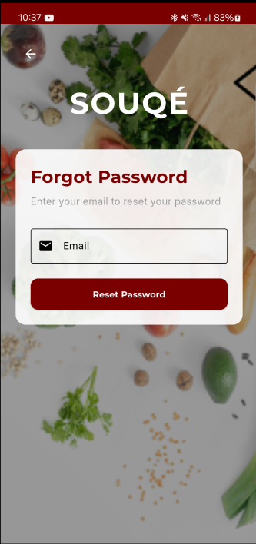
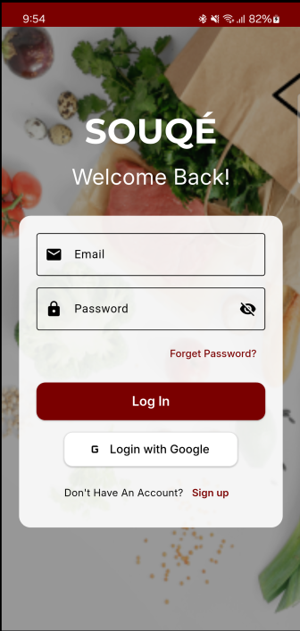
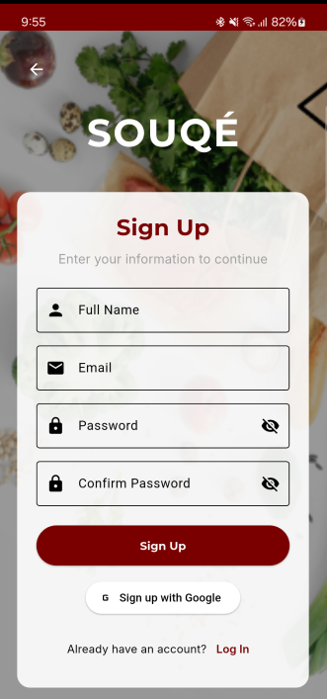
Log In , Sign Up
Users can easily sign in or sign up using email or Google, with options for password reset and account creation.

Slide 14

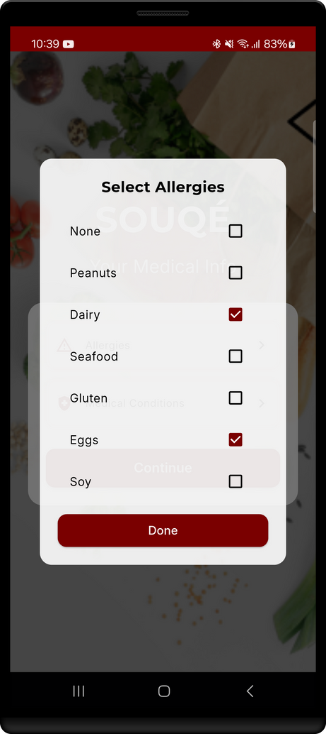
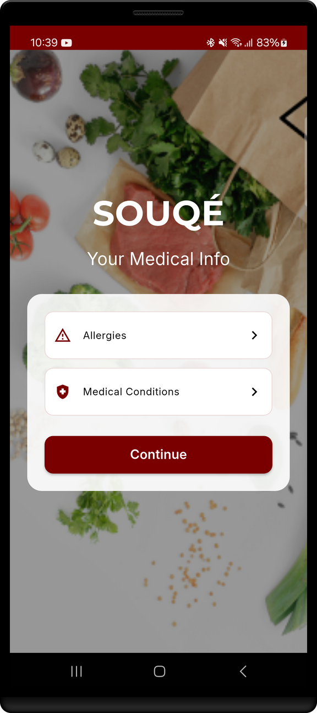

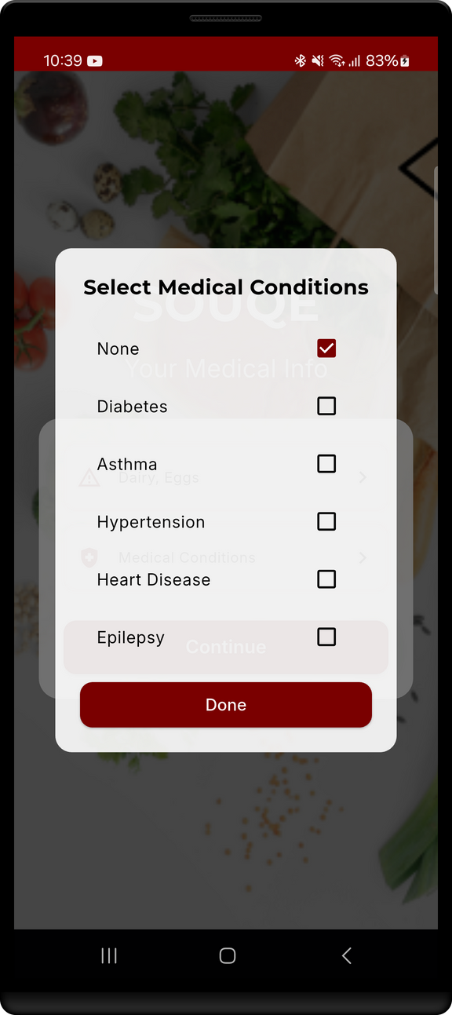
Select Allergy
Let users allergies and medical conditions to trigger allergy warnings

Slide 15
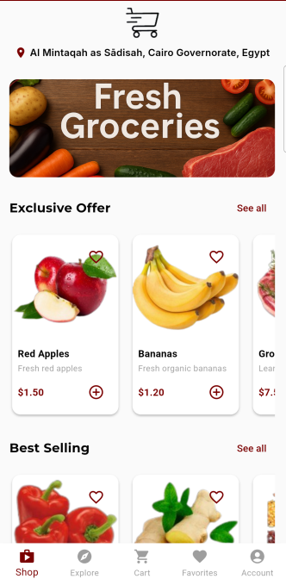
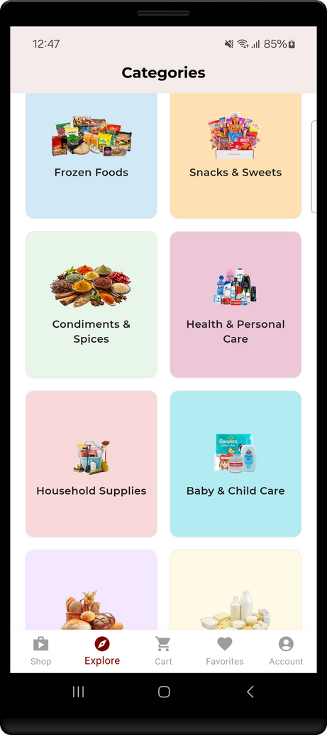
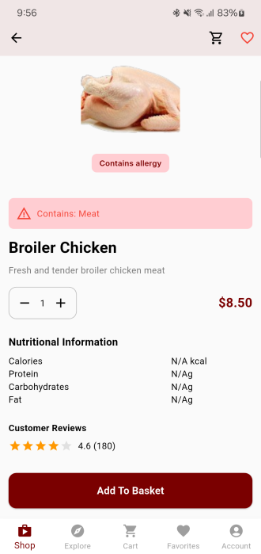
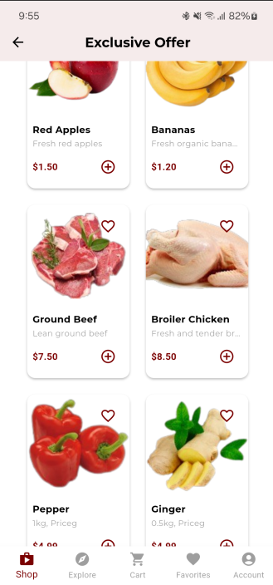
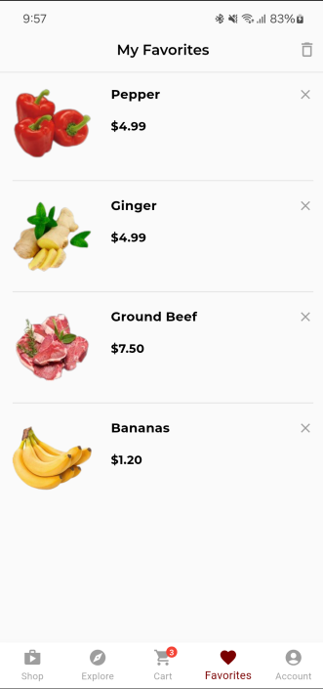
Home Screen

Slide 16
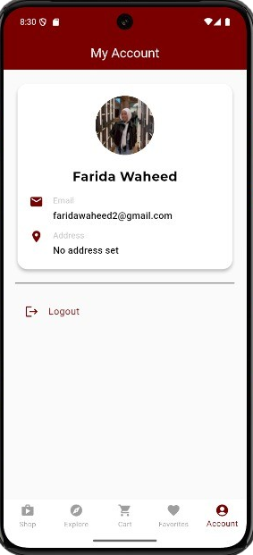
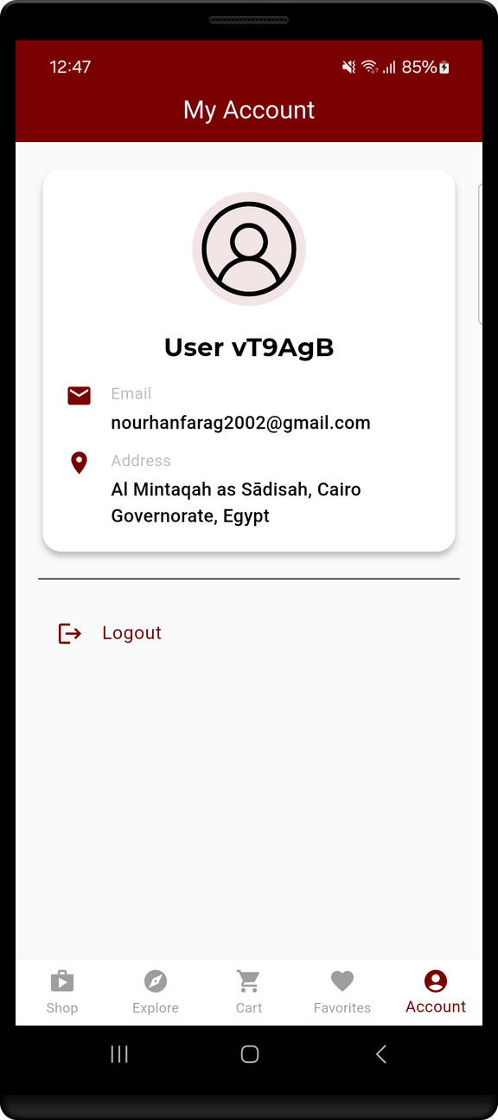

User Account

Slide 17
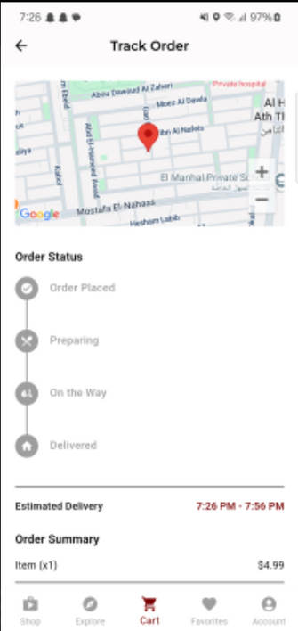
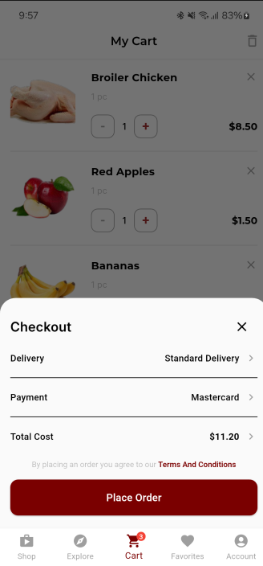
Order Time
What SOUQÉ Offers You
Easily review your cart and place orders securely.
Instant confirmation ensures clarity.
Live map tracking keeps users updated until delivery.

Slide 18
Our Team
01
Nourhan Farag Mohamed
02
Malak Mounir Abdellatef
03
Farida waheed Abdelbary
04
Nour Hesham El Sayed

Slide 19
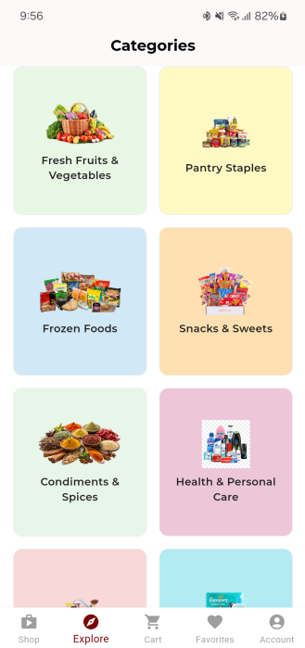
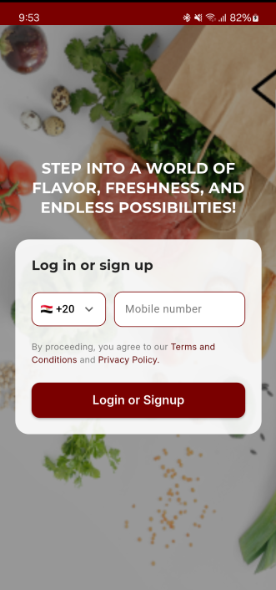
Thank You

